Slide 1

CS361: Computer Architecture
Instruction-level Parallelism..
Vector Processors
CS324 Computer Architecture 1

Slide 2
RECALL VECTOR
A vector is a one dimensional array of data items
V = [V₁ V₂ V₃ • • • V_{n}] represents a row vector V of length n
V^{T} is used to represent a column vector
V_{i} represents an element of vector V and the subscript i
refers to the memory address where the element is stored

Slide 3
VECTOR PROCESSOR
A conventional sequential computer is capable of processing one operand at a time.
Therefore, operations on vectors must be broken down into single computations with subscripted variables.
– For example, in the following loop that performs a vector arithmetic.
for (i=0;i<100; i++) C[i] = A[i] + B[i];
Vector Processors are used to speedup such operations

Slide 4
VECTOR PROCESSOR
A Vector processing architecture eliminates the overhead associated with the time it takes to execute the program loops.
It allows operations to be specified with a single vector instruction of the form
C(1:100) = A(1:100) + B(1:100)
The addition can be done with an array processor.

Slide 5
ARRAY PROCESSORS VS. VECTOR PROCESSORS
Rather than having multiple ALUs perform multiple additions simultaneously, such as in the array processors, the vector architecture pipelines the ALU to get good performance at lower cost.
For example in C(1:100) = A(1:100) + B(1:100), the addition can be done with a pipelined adder.

Slide 6
WHY NEED VECTOR PROCESSORS?
There is a class of computational problems that are beyond the capabilities of a conventional computer.
Such problems require a vast number of computations that will take a conventional computer days or even weeks to complete
In many science and engineering applications, the problems can be formulated in terms of vectors and matrices that lend themselves to vector processing
Some application areas:
Weather forecasting
Image processing
Medical diagnosis

Slide 7
RECALL INNER PRODUCT
The inner product of two vectors is equivalent to a column vector multiplied on the left by a row vector
𝑏₁
𝑏₂
⋮
𝑏_{𝑘}
𝐶 =
𝑎₁ 𝑎₂ … 𝑎_{𝑘}
𝐶 = 𝑎₁𝑏₁ + 𝑎₂𝑏₂ +⋯ +𝑎_{𝑘} 𝑏_{𝑘}
𝑘
𝐶 = ∑ 𝑎_{𝑖}𝑏_{𝑖}
𝑖=1
In a typical application k may be very large.

Slide 8
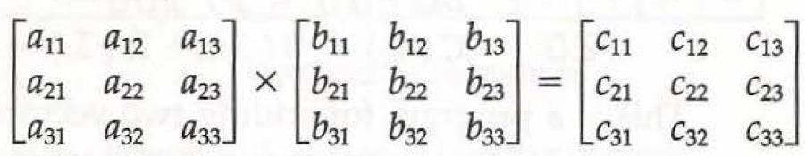
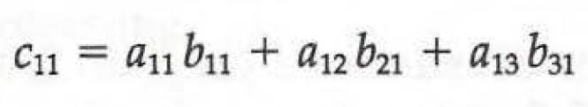
MATRIX MULTIPLICATION
Matrix multiplication is one of the most computational intensive operations performed with vector processors
The multiplication of two n x n matrices consists of n² inner products.
With each inner product requiring n multiply-add operations.
Consider, for example, the multiplication of two 3 x 3 matrices.
…

Slide 9
MATRIX MULTIPLICATION
Consider two 8 x 8 matrices, A and B
The first inner product will be:
𝐵₁
𝐵₂
⋮
𝐵₈
𝐶₁ =
𝐴₁ 𝐴₂ … 𝐴₈
= 𝐴₁𝐵₁ + 𝐴₅𝐵₅ +
𝐴₂𝐵₂ + 𝐴₆𝐵₆ +
𝐴₃𝐵₃ + 𝐴₇𝐵₇ +
𝐴₄𝐵₄ + 𝐴₈𝐵₈
Lets design a pipeline for calculating an inner product

Slide 10
PIPELINE FOR AN INNER PRODUCT
Source A
Source B
Multiplier pipeline
Adder pipeline

Slide 11
PIPELINE FOR AN INNER PRODUCT
All segment registers in the multiplier and adder are initialized to 0. Therefore, the output of the adder is 0 for the first eight cycles until both pipes are full.
– Ai and Bi pairs are brought in and multiplied at a rate of one pair per cycle.
After the first four cycles, the products begin to be added to the output of the adder. During the next four cycles 0 is added to the products entering the adder pipeline.
At the end of the eighth cycle, the first four products A1 B1 through A4B4 are in the four adder segments, and the next four products, A5 B5 through A8 B8, are in the multiplier segments.
At the beginning of the ninth cycle, the output of the adder is A1 B1 and the output of the multiplier is A5 B5. Thus the ninth cycle starts the addition A1 B1 + A5 B5. in the adder pipeline. The tenth cycle starts the addition A2 B2 + A6 B6, and so on.

Slide 12
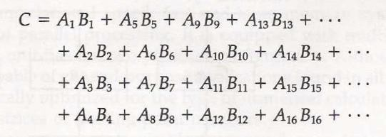
PIPELINE FOR AN INNER PRODUCT
This pattern breaks down the summation into four sections as follows:
When there are no more product terms to be added, the system inserts four zeros into the multiplier pipeline.
The adder pipeline will then have one partial product in each of its four segments, corresponding to the four sums listed in the four rows in the above equation. The four partial sums are then added to form the final sum through separate adders.

Slide 13
VECTOR VERSUS SCALAR ARCHITECTURES
Vector instructions have several important properties compared to conventional instruction set architectures, which are called scalar architectures in this context:
A single vector instruction specifies a great deal of work—it is equivalent to executing an entire loop.
The instruction fetch and decode bandwidth needed is dramatically reduced.
Hardware need only check for data hazards between two vector
instructions. Reduced checking can save power as well.
Because an entire loop is replaced by a vector instruction whose behaviour is predetermined, control hazards that would normally arise from the loop branch are nonexistent.
The savings in instruction bandwidth and hazard checking give vector architectures advantages in power and energy versus scalar architectures.

Slide 15
ARITHMETIC PIPELINE
Large numerical applications often make use of repeated arithmetic operations (loops) for processing the elements of vectors and arrays. Architectures specialized for such applications often provide pipelines to accelerate computation/ processing. This type of pipelining is
called arithmetic pipelining.
Arithmetic pipelining is a method of speeding up arithmetic computations by performing different parts of multiple operations in parallel.
Pipelined arithmetic units are used to implement vector processing for SIMD architectures
– used to implement floating-point operations, multiplication of fixed- point numbers, and similar computations encountered in scientific problems

Slide 16
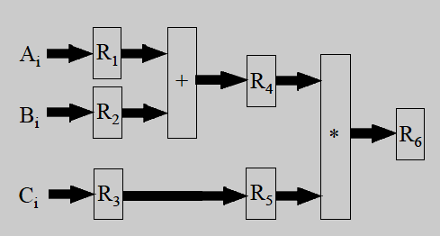
ARITHMETIC PIPELINING EXAMPLE
Consider the following loop:
for (i=1; i<=1000; i++)
X[i] = (A[i] + B[i]) * C[i];
A 3-stage arithmetic pipeline to perform this operation
The first segment loads A[i], B[i] and C[i] into registers R1, R2 and R3, respectively.
The second segment adds A[i] and B[i] and stores the result in R4. It also passes C[i] from R3 to R5.
The third segment multiplies R4 and R5 and stores them in R6.

Slide 17
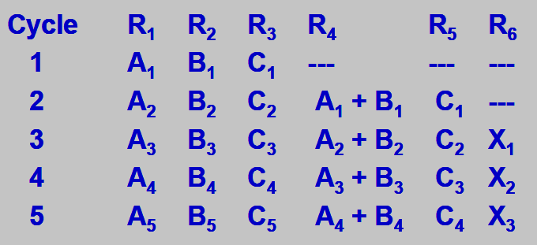
ARITHMETIC PIPELINING EXAMPLE
Data flow
Clock c
ycles | 1 | 2 | 3 | 4 | 5 | 6
1 | i=1 | i=2 | i=3 | i=4 | i=5 | i=6
2 |  | i=1 | i=2 | i=3 | i=4 | i=5
3 |  |  | i=1 | i=2 | i=3 | i=4
Segments
Space-time diagram
Note that pipelining doesn’t speed up individual computation. However, since new data is fed into the pipeline every clock cycle; therefore, a result is produced every cycle (once the pipe is full). This speeds up the computation of the entire task.
5

Slide 18
ARITHMETIC PIPELINE SPEEDUP
Speedup is a measure of the performance of a pipeline. It is the ratio of the time needed to process n pieces of data using a un-pipelined unit to the time needed using a pipelined unit.
The reduction in time using a pipeline rather than an un- pipelined unit:
n ∗ t_{n}
(k + n −1) * t_{p}
speedup =
t_{n} is the sequential (un-pipelined) processing time. It is equal to the sum of the times needed to carry out each operation plus the time needed to latch the final result.
t_{p} is the clock period of the pipeline. It is equal to the time of the slowest stage plus the time needed to latch the results.

Slide 19
SPEEDUP EXAMPLE
For the arithmetic pipeline shown on the previous slides, suppose that the adder segment takes t₁= 20 ns to do its task, the multiplier segment takes t₂= 25 ns and each register takes t_{r}= 5 ns to latch its results (i.e. time delay). What would be the speedup offered by the pipelined unit if the loop is to be executed 1000 times?
The clock cycle time t_{p} for this pipelined unit is chosen to be the time taken by the slowest stage plus the time delay to latch the results:
t_{p}= t₂ + t_{r} ➔ 25+5 = 30 ns
– This is because the slowest stage takes 25 ns to multiply data and 5
ns to latch the result.
An equivalent un-pipelined circuit will have a sequential time:
t_{n} = t₁ + t₂ + t_{r} ➔ 20 + 25 + 5 = 50 ns
In this case the pipelined unit offers a speedup:
speedup = ₍
n ∗ t
n
= ₍
1000 ∗ 50
3 + 1000 −1) ∗ 30
= 1.66
k + n −1) * t_{p}

Slide 20
ARITHMETIC VS. INSTRUCTION PIPELINE
An arithmetic pipeline divides an arithmetic operation into suboperations for execution in the pipeline segments, whereas an instruction pipeline operates on a stream of instructions by overlapping the fetch, decode, and execute phases of the instruction cycle.
– Arithmetic pipelines are used to speedup arithmetic computations. Instruction pipelines are used to speedup the fetch/decode/execute process of instructions.
Arithmetic pipelines promote vector processing for SMID Architecture (Data-level Parallelism)
Instruction pipelines promote Instruction-level Parallelism

